Slide 1
Introduction to Object-Oriented Programming
Lesson 2

Slide 2
Objective Domain Matrix
Skills/Concepts | MTA Exam Objectives
Understanding Objects | Understand the fundamentals of classes (2.1)
Understanding Values and References | Understand computer storage and data types (1.1)
Understanding Encapsulation | Understand encapsulation (2.4)
Understanding Inheritance | Understand inheritance (2.2)
Understanding Polymorphism | Understand polymorphism (2.3)
Understanding Interfaces | Understand encapsulation (2.4)
Notes:
Tip: Add your own speaker notes here.

Slide 3
Objects
Object-oriented programming is a programming technique that makes use of objects.
Objects are self-contained data structures that consist of properties, methods, and events.
Properties specify the data represented by an object
Methods specify an object’s behavior
Events provide communication between objects
Notes:
Tip: Add your own speaker notes here.

Slide 4
Classes
A class defines a blueprint for an object.
A class defines how the objects should be built and how they should behave.
An object is also known as an instance of a class.
Notes:
Tip: Add your own speaker notes here.

Slide 5
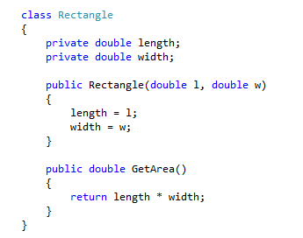
Defining a C# Class

Slide 6
Methods
A method is a block of code containing a series of statements.
A method defines the actions or operations supported by a class.
A method is defined by specifying the access level, the return type, the name of the method, and an optional list of parameters in parentheses followed by a block of code enclosed in braces.
Notes:
Tip: Add your own speaker notes here.

Slide 7
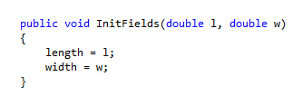
Method Example
The InitFields method takes two parameters and uses the parameter values to respectively assign the data field length and width.
When a method’s return type is void, a return statement with no value can be used.
If a return statement is not used, as in the InitFields method, the method will stop executing when it reaches the end of the code block.

Slide 8
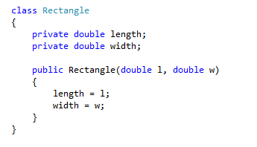
Constructors
Constructors are special class methods that are executed when a new instance of a class is created.
Constructors are used to initialize the data members of the object.
Constructors must have exactly the same name as the class and they do not have a return type.
Multiple constructors, each with a unique signature, can be defined for a class.

Slide 9
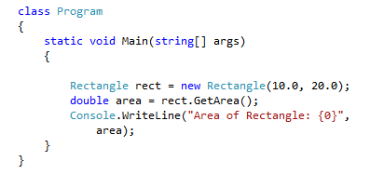
Creating Objects
Objects need a template that defines how they should be built.
All objects created from the same template look and behave in a similar way.

Slide 10
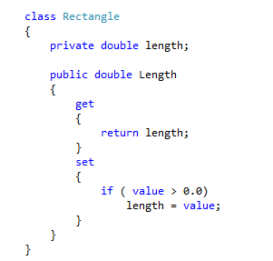
Properties
Properties are class members that can be accessed like data fields but contain code like a method.
A property has two accessors, get and set. The get accessor is used to return the property value, and the set accessor is used to assign a new value to the property.

Slide 11
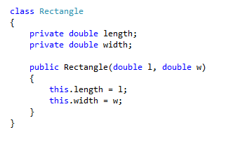
The this Keyword
The this keyword is a reference to the current instance of the class.
You can use the this keyword to refer to any member of the current object.

Slide 12

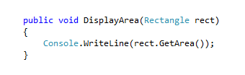
Delegates
Delegates are special objects that can hold a reference to a method with a specific signature.
Here, you define a RectangleHandler delegate that can hold references to a method that returns void and accepts a single parameter of the Rectangle type.
The signature of DisplayArea method matches the RectangleHandler delegate and therefore can be assigned to one of its instance.

Slide 13
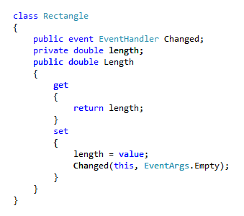
Events
Events are a way for a class to notify other classes or objects when something of interest happens.
The class that sends the notification is called a publisher of the event.
The class that receives the notification is called the subscriber of the event.

Slide 14
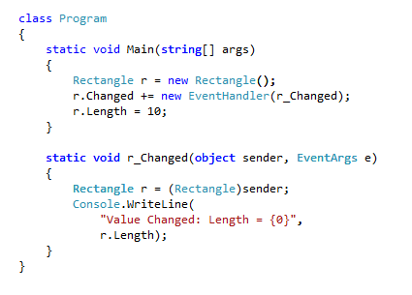
Subscribing to Events
The signature of the event handler method matches the requirements of the event’s delegate.

Slide 15
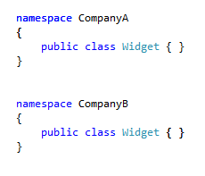
Namespaces
A namespace is a language element that allows you to organize code and create globally unique class names.
The .NET Framework uses namespaces to organize all its classes.
The System namespace groups all the fundamental classes.
The System.Data namespace organizes classes for data access.
The System.Web namespace is used for Web-related classes.

Slide 16
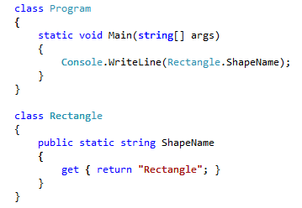
Static Members
The static keyword is used to declare members that do not belong to individual objects but to a class itself.
When an instance of a class is created, a separate copy is created for each instance field, but only one copy of a static field is shared by all instances.
A static member cannot be referenced through an instance object. Instead, a static member is referenced through the class name.

Slide 17
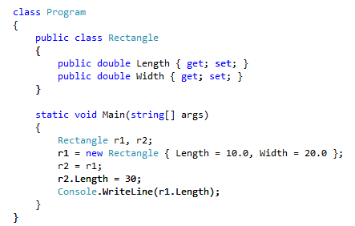
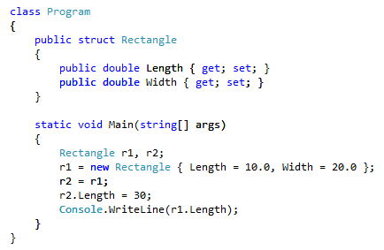
Values and References
A value type directly stores data within its memory.
Reference types store only a reference to a memory location. The actual data is stored at the memory location being referred to.
When you copy a reference type variable to another variable of the same type, only the references are copied. As a result, after the copy, both variables will point to the same object.

Slide 18
Encapsulation
Encapsulation is a mechanism to restrict access to a class or class members in order to hide design decisions that are likely to change.
Access modifiers control where a type or type member can be used.
Access modifier | Description
public | Access is not restricted.
private | Access is restricted to the containing class.
protected | Access is restricted to the containing class and to any class that is derived directly or indirectly from the containing class.
internal | Access is restricted to the code in the same assembly.
protected internal | A combination of protected and internal—that is, access is restricted to any code in the same assembly and only to derived classes in another assembly.

Slide 19
Inheritance
Inheritance is an OOP feature that allows you to develop a class once, and then reuse that code over and over as the basis of new classes.
The class whose functionality is inherited is called a base class.
The class that inherits the functionality is called a derived class
A derived class can also define additional features that make it different from the base class.
Unlike classes, the structs do not support inheritance.

Slide 20
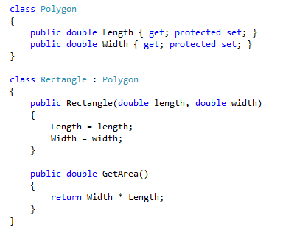
Inheritance - Example

Slide 21
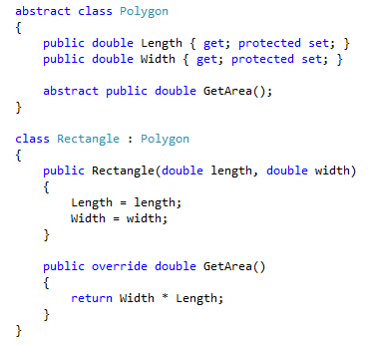
Abstract Classes
The abstract classes provide a common definition of a base class that can be shared by multiple derived classes.
The abstract class often provides incomplete implementation.
To instantiate an abstract class you must inherit from it and complete its implementation.

Slide 22
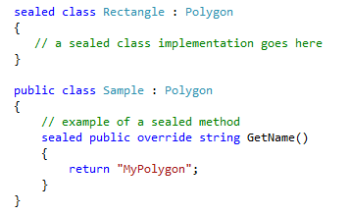
Sealed Classes
The sealed classes provide complete functionality but cannot be used as base classes.
Use the sealed keyword when your implementation is complete and you do not want a class or its member to be inherited.

Slide 23
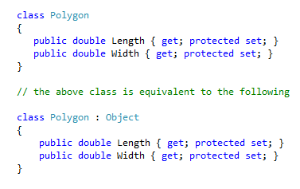
Inheriting from Object
The Object class is the ultimate base class of all the classes in the .NET Framework.
All classes in the .NET Framework inherit either directly or indirectly from the Object class.

Slide 24


Casting
In C#, you can cast an object to any of its base types.
All classes in the .NET Framework inherit either directly or indirectly from the Object class.
Assigning a derived class object to a base class object doesn’t require any special syntax:
Assigning a base class object to a derived class object must be explicitly cast:
At execution time, if the value of o is not compatible with the Rectangle class, the runtime throws a System.InvalidCastException.

Slide 25

The is Operator
To avoid runtime errors such as InvalidCastException, the is operator can be used to check whether the cast is allowed before actually performing the cast.
Here, the runtime checks the value of the object o. The cast statement is only executed if o contains a Rectangle object.

Slide 26
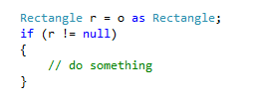
The as Operator
The as operator is similar to the cast operation but, in the case of as, if the type conversion is not possible, null is returned instead of raising an exception.
At runtime, if it is not possible to cast the value of variable o to a rectangle, a value of null is assigned to the variable r. No exceptions will be raised.

Slide 27
Polymorphism
Polymorphism is the ability of derived classes to share common functionality with base classes but still define their own unique behavior.
Polymorphism allows the objects of a derived class to be treated at runtime as objects of the base class. When a method is invoked at runtime, its exact type is identified, and the appropriate method is invoked from the derived class.

Slide 28
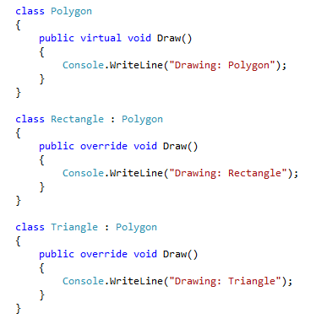
Polymorphism - Example
Consider the following set of classes:

Slide 29
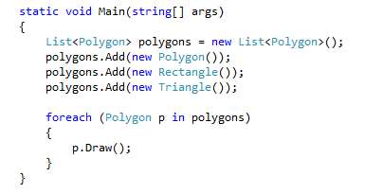
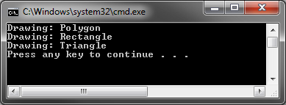
Polymorphism - Example

Slide 30
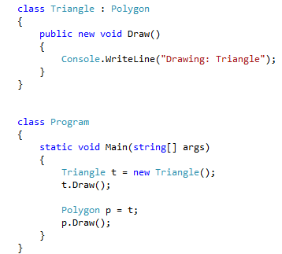
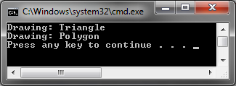
The override and new Keywords
The override keyword replaces a base class member in a derived class.
The new keyword creates a new member of the same name in the derived class and hides the base class implementation.

Slide 31

Interfaces
Interfaces are used to establish contracts through which objects can interact with each other without knowing the implementation details.
An interface definition cannot consist of any data fields or any implementation details such as method bodies.
A common interface defined in the System namespace is the IComparable namespace. This is a simple interface defined as follows:
Each class that implements IComparable is free to provide its own custom comparison logic inside the CompareTo method.

Slide 32
Recap
Objects
Classes, methods, properties, delegates, events
Namespaces
Static members
Values and References
Encapsulation
Access Modifiers
Inheritance
Abstract and sealed classes
Casting, is and as operators
Polymorphism
Override and new keywords
Interfaces

